Slide 1


Slide 2


Customer Experience Analytics for abc Insurance Company
In this project, we'll delve into the world of Customer Experience
(CX) analytics, focusing on the inbound calling team of abc
Insurance Company. Analyzing call volume data aids in
understanding customer behaviors, predicting peak periods,
optimizing staffing, and enhancing overall customer experience.
SG
by Shivangi Gupta

Slide 3

Project Description
INTRODUCTION
This project focuses on Customer Experience (CX)
analytics within the inbound calling team of abc Insurance
Company.
It aims to analyze call volume trends, durations, and
other key metrics to derive actionable insights for
enhancing customer support operations.

Slide 4
Customer Experience (CX) Analytics
Customer Experience (CX) Analytics is a process that allows businesses to understand their customers' interactions and experiences with their products or services.
It involves the collection, analysis, and interpretation of customer data to gain insights into customer behavior, preferences, and expectations.
By analyzing data on customer behavior, preferences, and feedback, CX Analytics helps businesses tailor their offerings, personalize experiences, improve customer service, and make informed decisions.

Slide 5




Enhancing Customer Experience with AI
Interactive Voice Response(IVR)
Robotic Process Automation(RPA)
Predictive Analytics
Intelligent Routing
Enhances CX with personalized interactions, efficient routing, 24/7 availability, self-service, and improved efficiency..
Boosts CX with automation, shorter wait times, increased accuracy, and faster issue resolution.
Anticipates customer needs, driving proactive service, personalized recommendations, and targeted marketing.
Streamlines customer service by directing inquiries to the best-suited agents, minimizing wait times, and increasing satisfaction.

Slide 6

Inbound Customer Support
An inbound call refers to a call that a customer makes to the call center.
These calls mainly revolve around offering assistance with customer’s queries or providing them with technical support.
Nowadays, customers can contact the call center through email, chat, or telephone calls. Inbound calls allow companies to provide excellent support to the customers while allowing businesses to focus more on core operations.
Using Inbound call services, you can offer your customers the best customer experience ensuring your business does not face any revenue losses.

Slide 7




Role of Customer Service Representatives
Key
Responsibility
Communication
Skills
Product
Knowledge
Problem-Solving
Abilities
Managing Inbound Inquiries
Resolving Customer
Issues
Providing Assistance
and Guidance
Ensuring Customer Satisfaction
Clear and concise
Communication
Empathy and Understanding
Active Listening to Customer Concerns
In-depth
Understanding of
Company Offerings
Continuous
Learning to Stay
Updated
Analyzing
Customer Needs
Finding
Efficient Solutions
Handling Challenging
Situations with Ease

Slide 8

Advertising and Business Understanding
Advertising’s Role
Advertising is vital for increasing sales, building brand awareness, shaping first impressions, and attracting customers by strategically communicating value propositions to target audiences..
Target Audience
Businesses target local, regional, national, or international audiences through tailored advertising channels
like online directories, radio, TV, and more, aligning strategies with the geographic scope of their target markets.
Competitive Landscape
Analytical skills are crucial in the competitive advertising industry for identifying cost-effective media platforms
that maximize reach and engagement with target audiences.
Business Understanding
Analytics plays a pivotal role in understanding customer behavior, predicting peak periods, and optimizing
advertising strategies for enhanced customer acquisition and retention.

Slide 9




Data Analytics Tasks
Average Call
Duration
Call Volume
Analysis
Manpower
Planning
Night Shift Man power Planning
Calculate the average duration of calls for each time bucket.
Visualize the total
number of calls
received in each
time bucket..
Propose a plan for
allocating agents
during each time
bucket to reduce
the abandon rate
to 10%.
Devise a plan to handle calls received at night to maintain a maximum abandon rate of 10%.

Slide 10
Approach
Data
Cleaning
Data
Visualization
Understood the variables included in the dataset.
Identify any potential data quality issues, missing values, or inconsistencies.
Descriptive Analysis
Predictive Analysis
Handled missing values and inconsistencies.
Ensured data integrity for accurate analysis.
Utilizing interactive visualizations to allow for deeper exploration of the data and patterns.
Data
Understanding
Data
Analysis

Slide 11


Tech-Stack Used
Microsoft PowerPoint 2007
Microsoft Excel 2007
Presentation
Data Understanding
Data Cleaning
Data Analysis
Data Visualization

Slide 12

Dataset Description
The dataset spans a 23-day period and includes information about inbound calls received by abc Insurance Company.
The dataset covers inbound calls received during operational hours from 9 am to 9 pm.
Key Variables
Agent's Name and ID
Wrapped by (Auto wrapped, answered)
Customer’s Phone Number
Date and Time
Time Bucket
Call Time
Call Duration
Call Status (Abandon, Answered, Transfer)

Slide 13

Dataset Understanding
Variable: Agent’s Name and ID
Approximately 29% of entries in the "Agent Name
and ID" variable are filled with "#N/A“ , indicating that
no agent attended the incoming calls.
Calls with "#N/A" in the "Agent Name and ID" variable
correspond to the "abandoned" status, signifying
instances where customers' calls were not answered
by an agent.
Variable: Wrapped_By
Approximately 41% of the calls are NULL.
A significant portion of null cells in the "Wrapped by" variable corresponded to abandoned calls.

Slide 14
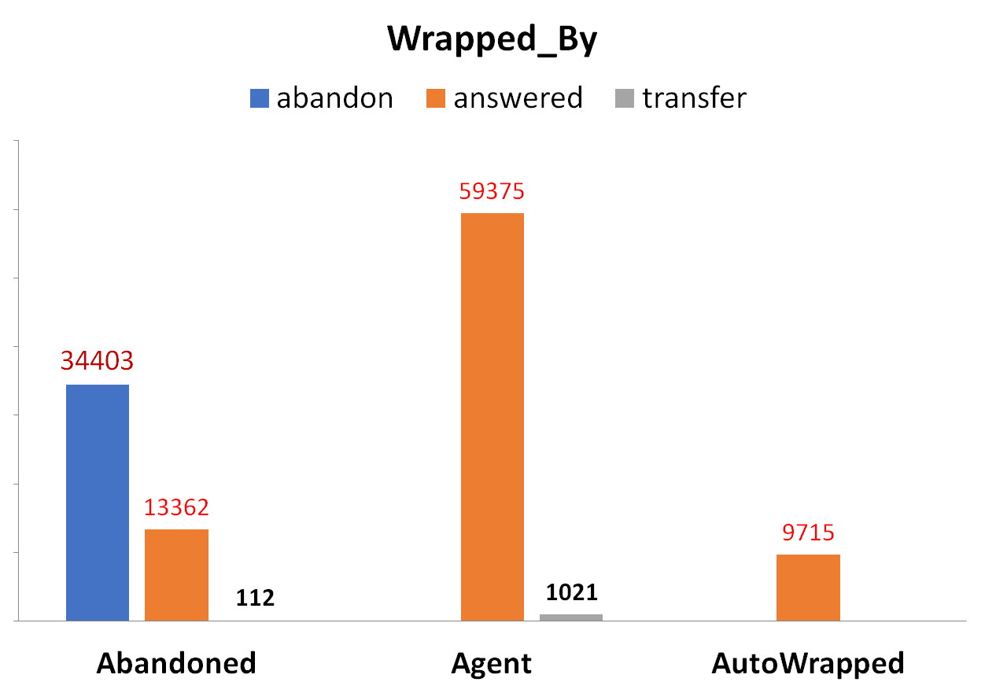
Data Cleaning
Handling Null Cells in "Wrapped by“
Variable:
Filled NULL cells with "Abandoned" to accurately reflect the call status.
This decision was based on the observed correlation between NULL cells and abandoned
calls, aiming to maintain consistency and
accuracy in the dataset for subsequent
analysis.

Slide 15

Average Call Duration Analysis (1/2)
Description:
Analyzing the average duration of inbound calls for each time bucket to understand the distribution of call
durations throughout the day.
Methodology Used for Analysis:
Calculated the average call duration for each time bucket using Pivot Table.

Slide 16
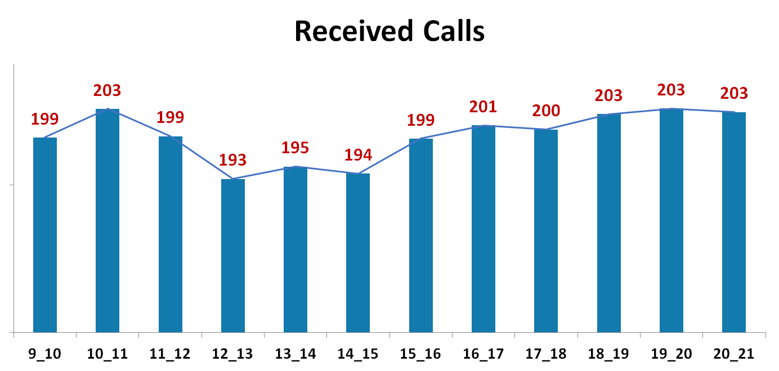
Average Call Duration Analysis (2/2)
Insight:
The average call duration is
199 Seconds.
TIME BUCKET

Slide 17

Call Volume Analysis (1/2)
Description:
Analyzing the total number of inbound calls received in each time bucket to understand call volume trends
throughout the day.
Methodology Used for Analysis:
Aggregated the number of calls received in each time bucket.
Visualized the call volume using charts or graphs.

Slide 18
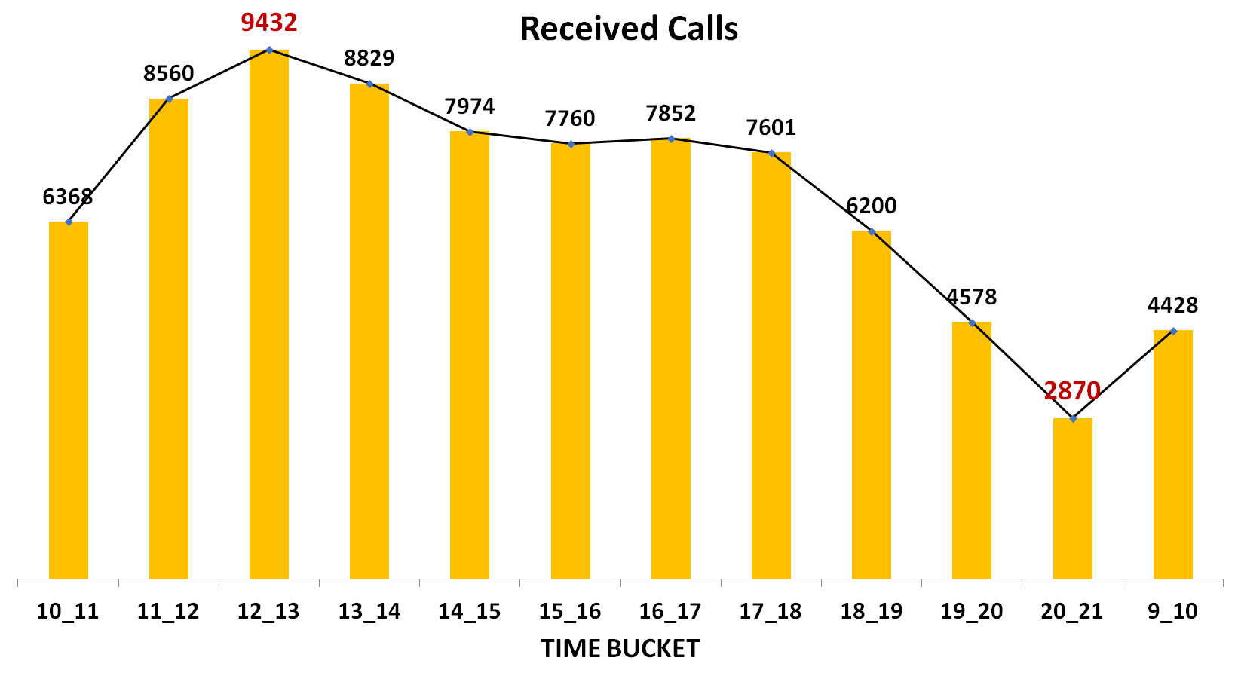
Call Volume Analysis (2/2)
Insight:
Peak Hours of Call Activity-
11AM-02PM
2. Fluctuations in call volume-
Gradually decreases
throughout afternoon, with
significant drops during
the 19PM-21PM time interval.

Slide 19

Manpower Plan(1/3)
Description:
Proposing a plan for allocating agents during each time bucket to reduce the abandon rate to 10%.
Methodology Used for Analysis:
Calculated percentage of abandon rates in each time bucket.
Calculated the minimum number of agents required in each time bucket based on the abandon rate target 10%.
Considered historical call data and projected call volume trends.
Visualized the “Agents Present Vs Required” using charts or graphs.

Slide 20
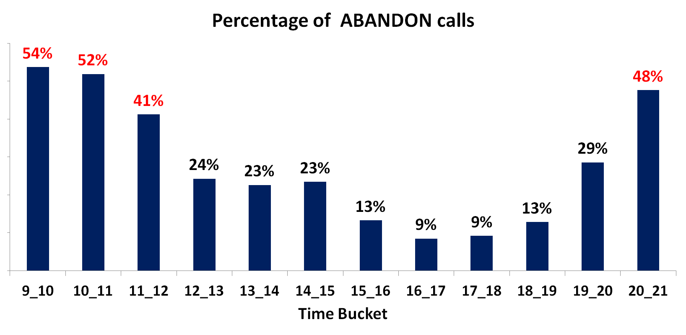
Manpower Plan (2/3)
High rates of abandoned calls are observed during peak periods from 9 AM to 12 PM and from 8 PM to 9 PM. Conversely, lower abandonment rates are noted during the afternoon.

Slide 21

Assumptions
Agents work for 6 days a week.
Each agent takes 4 unplanned leaves per month.
An agent’s total working hours per day are 9 hours per day.
1.5 hours are spent on lunch and snacks in the office.
On average, an agent spends 60% of their actual working hours on
calls with customer/users.
6. The total number of days in a month is 30.
For every 100 calls that customers make between 9 am and 9 pm,
they also make 30 calls at night between 9 pm and 9 am.

Slide 22
Assumptions-Based Insights
Actual Working Hours: 7.5 hours (subtracting lunch and snacks)
b) Data is provided for first 23 days.
c) Average Call Duration: 199 Seconds or 0.05528 Hours
d) Agent’s Efficiency: 0.6 X 7.5Hours = 4.5 Hours
A) Calculate total available working hours per agent per month: 23 days X 7.5hours = 172.5 Hours
B) Calculate Effective Call Handling hours per agent per month: 0.60 X 172.5 hours = 103.5 Hours
C) Calculate the total number of calls an agent can handle per month: 103.5 X 0.05528 = 1872 calls
D) Calculate the total number of calls an agent can handle per day: 1872 / 23 days = 81 calls
E) Calculate the total number of calls an agent can handle per hour: 81 / 4.5 hours= 18 calls

Slide 23

Methodology: Calculating Required Agents
Desired Abandon Rate = 10%
Answered Calls = Total Calls X (1- Desired Abandon Rate)
Agents Required per hour =
Answered Calls
Total number of calls an agent can handle per hour

Slide 24
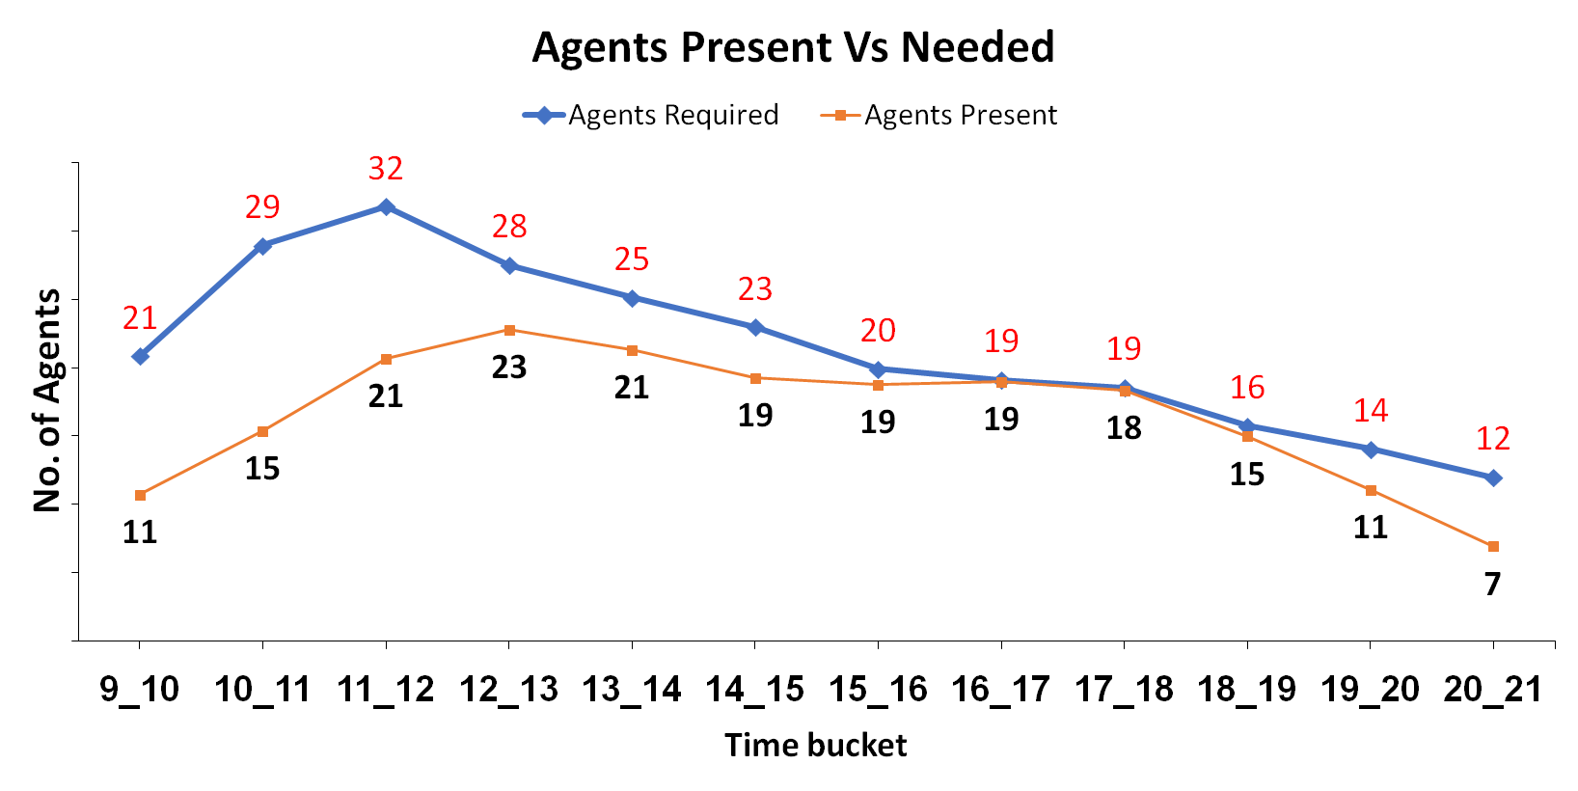
Manpower Plan (3/3)
TIME BUCKET (DAY SHIFT) | TOTAL INCOMING CALLS | ANSWERED CALLS (10% ABANDON RATE) | AGENTS REQUIRED
9-10 | 417 | 375 | 21
10-11 | 579 | 521 | 29
11-12 | 636 | 572 | 32
12-13 | 550 | 495 | 28
13-14 | 503 | 452 | 25
14-15 | 459 | 413 | 23
15-16 | 398 | 358 | 20
16-17 | 382 | 344 | 19
17-18 | 371 | 334 | 19
18-19 | 315 | 283 | 16
19-20 | 281 | 253 | 14
20-21 | 239 | 215 | 12

Slide 25
Night-Shift Manpower Plan(1/2)
Description:
Proposing a manpower plan for handling calls received at night to maintain a maximum abandon
rate of 10%.
Methodology Used for Analysis:
Estimated the number of calls received at night based on historical data and assumptions provided.
Calculated the minimum number of agents required during night shifts to meet service level targets.

Slide 26
Assumptions-Based Insights
TIME BUCKET (NIGHT-SHIFT) | CALL DISTRIBUTION | PERCENTAGE DISTRIBUTION
9PM-10PM | 3 | 0.1
10-11 | 3 | 0.1
11-12 | 2 | 0.0667
12AM-01AM | 2 | 0.0667
1-2 | 1 | 0.0333
2-3 | 1 | 0.0333
3-4 | 1 | 0.0333
4-5 | 1 | 0.0333
5-6 | 3 | 0.1
6-7 | 4 | 0.1333
7-8 | 4 | 0.1333
8AM-9AM | 5 | 0.1667
For every 100 calls
that customers make
between 9 am and
9 pm, they also make
30 calls at night
between 9 pm and
9 am.

Slide 27
Night-Shift Manpower Plan(2/2)
TIME BUCKET (NIGHT-SHIFT) | PERCENTAGE DISTRIBUTION OF NIGHT CALLS | TOTAL INCOMING CALLS (10% RATE) | AGENTS REQUIRED
9PM-10PM | 0.1 | 139 | 8
10-11 | 0.1 | 139 | 8
11-12 | 0.0667 | 92 | 5
12AM-01AM | 0.0667 | 92 | 5
1-2 | 0.0333 | 46 | 3
2-3 | 0.0333 | 46 | 3
3-4 | 0.0333 | 46 | 3
4-5 | 0.0333 | 46 | 3
5-6 | 0.1 | 139 | 8
6-7 | 0.1333 | 185 | 10
7-8 | 0.1333 | 185 | 10
8AM-9AM | 0.1667 | 231 | 13

Slide 28
Key Takeaways
Average Call Duration:
An average call duration of 199 seconds indicates that customer interactions with typically last around 3 minutes and 19 seconds, offering insights into call efficiency and service quality.
Call Volume Analysis:
Peak call activity observed during midday, followed by gradual decline in the afternoon and evening guides staffing adjustments for optimal resource allocation during peak hours.
Addressing abandonment rates:
High rates of abandoned calls during peak periods from 9 AM to 12 PM and from 8 PM to 9 PM, with lower abandonment rates observed in the afternoon, highlight fluctuations in call abandonment throughout the day.
Manpower Plan:
Proposing a manpower plan for day and night shifts ensures round-the-clock support for customer and enhances overall customer experience.

Slide 29

Recommendations
Implement flexible staffing aligned with peak call hours to minimize wait times and enhance
customer satisfaction.
Utilize call routing strategies and automation for efficient call management.
Provide training and support for night shift agents to ensure consistent service quality and
customer satisfaction.

Slide 30
Limitations
Assumptions:
The project's findings and recommendations are based on certain assumptions, such as agent efficiency and call duration, which may not fully reflect real-world scenarios.
2. Scope:
The analysis focuses solely on inbound call data, overlooking other channels of customer communication such as emails or chat support, which could provide additional insights.
Data Limitations:
The project relies on a specific dataset, which may not capture all nuances of customer interactions or account for external factors influencing call volume and duration.

Slide 31
Challenges
Data Quality:
Ensuring the accuracy and completeness of the dataset, including addressing missing or
inconsistent data entries.
2. Assumptions Validation:
Verifying the accuracy of assumptions made regarding agent efficiency, call duration, and
other variables required careful validation to ensure the reliability of findings.

Slide 32
Conclusions
The analysis of inbound call data has provided valuable insights for ABC Insurance Company.
By optimizing staffing levels and addressing peak call periods, the company can enhance customer
satisfaction.
Despite challenges, the project underscores the importance of data-driven decision-making in
improving operational efficiency and service quality.
Ongoing monitoring and adaptation will be crucial for maintaining success and competitiveness in
the insurance industry.

Slide 33


